Slide 1
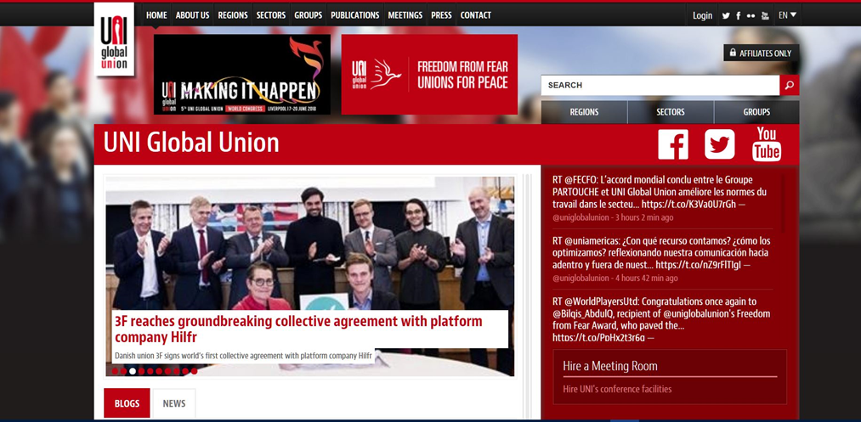

Slide 2
Dealing with gender inequality in collective agreements
The problem with participation
The problem with equal pay
The problem with work life balance

Slide 3
Digital workplatforms – a revolution?
New participation model
New model for fixing pay
New flexibility model and conditions for work life balance

Slide 4
Summary: Digital workplatforms changed the market, but…
- Created new problems in the struggle for gender equality.

Slide 5
The Hilfr agreement
Wage equality
Maternity leave and pay.
Education funds

Slide 6
The Hilfr Case Study - the hidden dynamics of the digital work platform
Digital workplatforms and work life balance
Digital workplatforms and the wage-dynamics
Digital workplatforms and the accelerating transformation from fixed hours to precariouse work
Digital workplatforms and the “showcase-model” (gender profiling)

Slide 7
Conclusion: Best case findings of the Hilfr collective agreement
Digital work platforms can:
Increase possibilities for equal participation in the Labour market.
Collective agreements can:
Create higher levels of equal pay.
Secure maternity leave-schemes and pay.
Introduce Education funds and plans.
But we still need to solve the problems of:
Work life balance and the demand for flexibility
Acceleration of precarious work
Acceleration og gender profiling

