Slide 1
Digital Upskilling and engagement of the ageing workforce in TIM
June 3rd 2021

Slide 2
Generations in TIM
The average age of people, in TIM, is about 52 years. In the next 10 years we will have a prevalent population of people over-60.
More than 78% of the workforce are over 50
39,6%
Baby boomers
54,9%
Generazione X
5,6%
Generazione Y and Z (Millennials)
As the generations change, so do the demands and expectations: speaking of welfare services, for example, one of the main demands concerns the expansion of services and benefits related to health and wellness.

Slide 3
New competencies needed
Our company is technologically advanced even if technological skills traditionally belong to the telcos environment and need to be enriched with a boost from the “agile” world brought by OTT
TELCO INFRASTRUCTURE COMPETENCIES + AGILE & OTT = TIM 2021
This change is urgently required also by the evidenxe of our most recent partnership with some of the OTT like Google..

Slide 4
Goals of the project
Aligning skills with business innovation
Pathways for updating skills and aligning them with technological innovation that offer an overall view of technological evolution, inside and outside the company
Developing skills needed for organizational evolution
Training content that supports smart working and the extension of Agile projects, with a focus on enabling technologies and mindset
Enhancing educational offerings through government support
Development of the NexTIM training plan, supported by "Fondo Nuove Competenze"

Slide 5
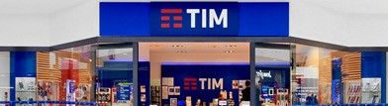
Targets
Improvement of customer management, from activation to delivery to customers' homes;
New equipment, products and services and new systems and procedures;
Job security and health issues, for the prevention of accidents in compliance with current regulations
On-site and online technicians
development and deployment of 5G
delivery and operational management of IT applications and software products
business services realized through sw systems
design of ICT systems and secure IT systems
testing activities of systems and integrated system chains
Operation, Network, ICT
Improvement of customer management, from activation to delivery to customers' homes;
New equipment, products and services and new systems and procedures;
Job security and health issues, for the prevention of accidents in compliance with current regulations
Pre and post sales people

Slide 6
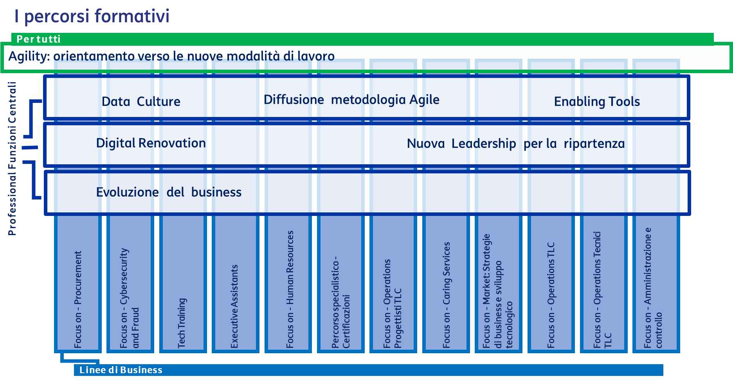
Fondo Nuove Competenze
Thanks to the “Fondo Nuove Competenze" it was possible to develop the NexTIM Plan: 3.361.347 hours and 37.585 employees involved.
Training paths:
7 dedicated to the skills needed for organizational change
12 specialized for each professional family
Anticipated by:
a survey on Motivation and Employability
4 skill assessment paths with focus on digital skills, remote work, Agility and Data Driven
analysis with company managers, also through focus groups
101 training courses, with a final test to verify the skills achieved
A certification document of competences, which can be validated and certified at national and European level.

Slide 7
Labor unions envolvment
The involvement of Labor Unions is substantiated:
1) in sharing and signing of the agreements containing training plans
2) in structured moments of monitoring, through dedicated joint commissions, of the contents of the Plans.
In recent years it happened thrice:
Expansion contract 2019
NexTIM training program 2020/2021
Expansion contract 2021

Slide 8
Piano NexTIM
Gigabit Society
Directed to all TIM workforce, it includes 7 webinars on the main drivers of the evolution towards the Gigabit Society
Digital Workplace
Digital technology and a new user experience are revolutionizing the way of working: the path to learn how to use the new tools for remote collaboration
5G New Competencies
5G is the technology that will surpass the current 4G LTE. Training path dedicated to the commercial and technical world
Tech Smart Working
Digital technologies make new ways of working possible and are a key driver for the development of Smart Working
90.000 hours of training provided
17.000 people involved
77.000 hours of training provided
13.000 people involved
40.000 hours of training provided
300 people involved
37.000 hours of training provided
All TIM people involved

Slide 9
Piano NexTIM
Big Data
The course aims to give an understanding of the architectural complexity of Big Data and the strategy based on an Enterprise Data Hub
5G Evolution
The course aims to develop, enhance and evolve skills on 5G enabling the development and sale of new services
Security Awareness
Information security awareness is a necessary orientation to operate at its best with the new ways of working
ICT Innovation
Native Cloud Development, IT Infrastructure and Cloud and Programming Language and Web specialist paths
4.000 hours of training provided
1.000 people involved
75 hours of training provided
All Sales people involved
260.000 hours of training provided
All TIM people involved
40 hours of training pro capite provided
2.500 people involved

Slide 10
Piano NexTIM
Cyber Security
Protecting your company's IT system means securing your company's data: seminars and testimonials from security experts
Together
The course aims to develop, enhance and evolve skills on 5G enabling the development and sale of new services
The New@Normal
Webinar on change management, leadership, remote meeting management. Workshop on self-awareness, new Mindset, Flow
Planet Sales
Techniques and methodologies for the reorganization of the area through training interventions of skill upgrading and adaption
110.000 hours of training pro capite provided
15.700 people involved
40 hours of training pro capite provided
1.300 people involved
1.500 hours of training provided
80 people involved
75.600 hours of training provided
2.700 people involved

Slide 11
Piano NexTIM
Google Green
Train resources that will be involved in migrating and managing all GCP workloads in the coming months and years
Certifications
PMI - PMO - JUMIPER - ITIL - CISCO and other numerous certifications issued every year to our employees
G Suite
Didactics and exercises on the functionalities and potentialities of the Google Suite for remote collaboration and remote relationship
Data Driven Cult.
Pathway to address digital transformation: enabling technologies, artificial intelligence, data culture
100/150 hours of training pro capite provided
Over 1.000 people involved
12 hours of training pro capite provided
2.600 people involved
11.000 hours of training provided
28.000 people involved
600.000 hours of training provided
All TIM people involved

Slide 12
Piano NexTIM
Digital Enterprise
Specialized training on active and passive cycle functionality, asset management and finance on SAP HANA ERP platform
Linguistic Training
Comprehensive language training program for all employees
Regulatory Training
Align knowledge of regulatory regulations and processes related to equal treatment
Reskill. For Job Rotat.
monitoring of training learning of TIM people in job rotation
94.230 hours of training provided
20.000 people involved
16.000 hours of training provided
5.300 people involved
15.000 hours of training provided
1.700 people involved
2.000 people involved per year

Slide 13
Longevity Program
TIM is launching a multifaceted plan of initiatives to fully integrate more mature people and overcome age-related stereotypes.
Stemming the decline in productivity with a company population that is 50% 60 years old
Understanding how to foster intergenerational dialogue
Valuing everyone's contribution, while respecting the diversity offered by the company's life cycle
Longevity Program
We chose to go beyond the treatment of the generational theme as a "comparison between generations" and preferred the concept of working longevity aimed to the physical, psychological and motivational well-being of our people, until the end of the collaboration experience with TIM
Longevity Program redesigns the company and its processes in function of the increase of working longevity and concerns:
Welfare services
The system for developing and measuring potential
Ad hoc training plan
Final goal: to consolidate mental capital and mental wellbeing, the conditions for realizing one's potential, being productive and creative and being with others.

Slide 14
Longevity Program: steps
1
2
3
4
5
6
WORK DRIVERS MAP
All +55 employees mapped on a 2 drivers matrix: employability and engagement
LONGEVITY WORKER ID CARD
Identikit of the fully engaged and employable longevity worker
OVERALL TRAINING
E—learning and sync traning on age bias and longevity working for:
All workforce
HR BP
Managers
SPECIFIC TRAINING
E—learning for the specific longevity targets:
Uptrends
Masters
Costrained
Underwater
WELLBEING
physical activity
stress reduction
Lifestyles
prevention
PRE-RETIREMENT & CELEBRATION

